Slide 1


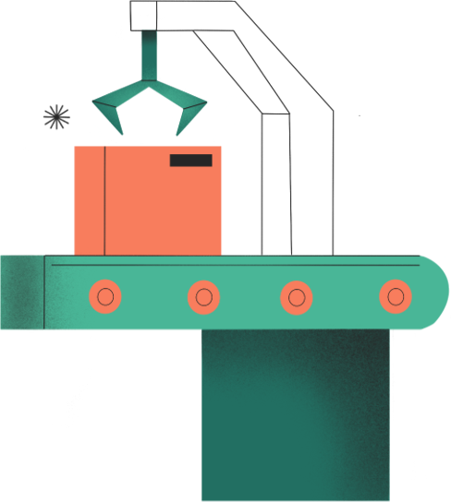
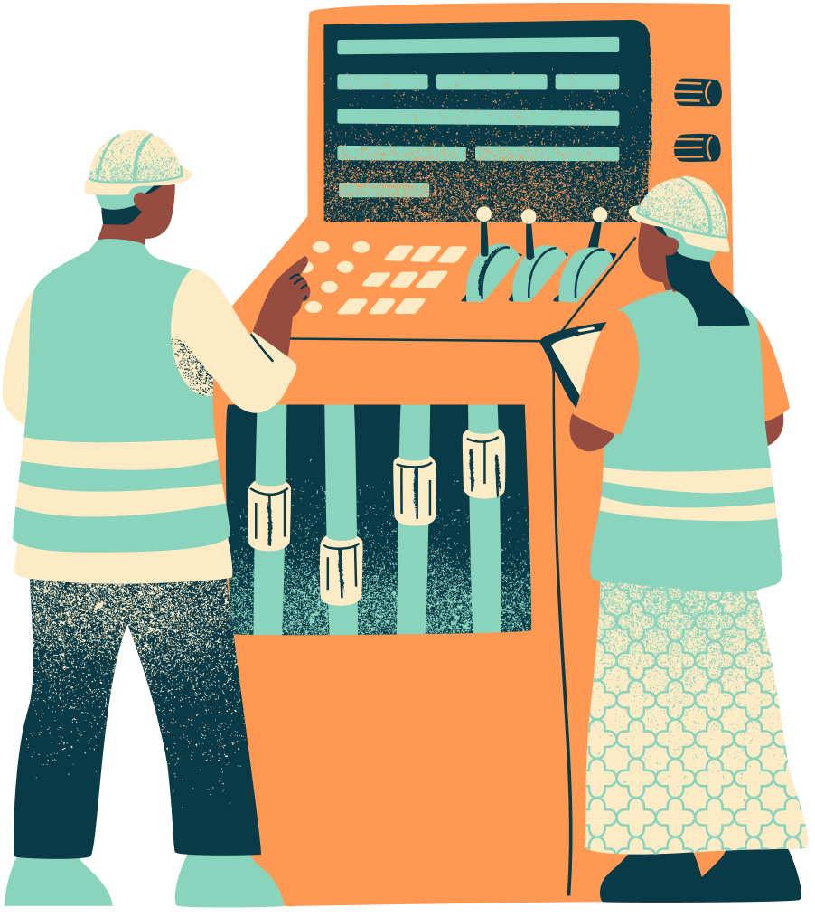
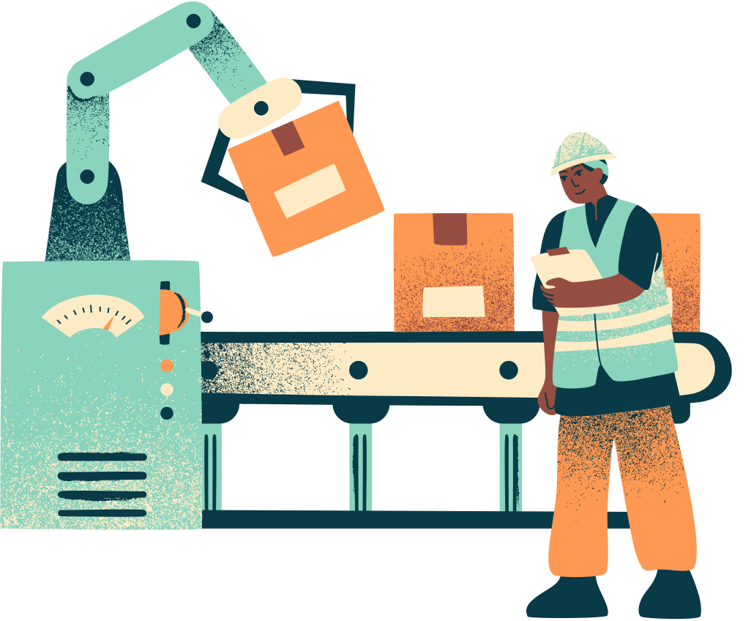
Presentation
AI-POWERED PREDICTIVE MAINTENANCE

Slide 2
Bassant Yasser
Tasnim Adel
Ziad Ahmed
Ahmed Mohamed
Our Team

Slide 3



EXECUTIVE SUMMARY
98.1%
30-40%
50%
Accuracy
Cost Savings
Downtime Reduction
THE CHALLENGE
OUR SOLUTION
Unplanned machine failures cost manufacturers millions annually in lost production, emergency repairs, and safety incidents. Traditional reactive maintenance is no longer sufficient.
An AI-powered predictive system that analyzes real-time sensor data to forecast machine failures before they occur, enabling proactive maintenance and maximizing operational efficiency.

Slide 4




THE BUSINESS PROBLEM
Unplanned Downtime: The Hidden Cost
Production Loss
Average cost: $260,000 per hour for automotive manufacturing
Emergency Repairs
Reactive maintenance costs 3-9x more than planned maintenance
Safety Incidents
Equipment failures lead to workplace injuries and liability
Revenue Impact
Missed delivery deadlines damage customer relationships

Slide 5
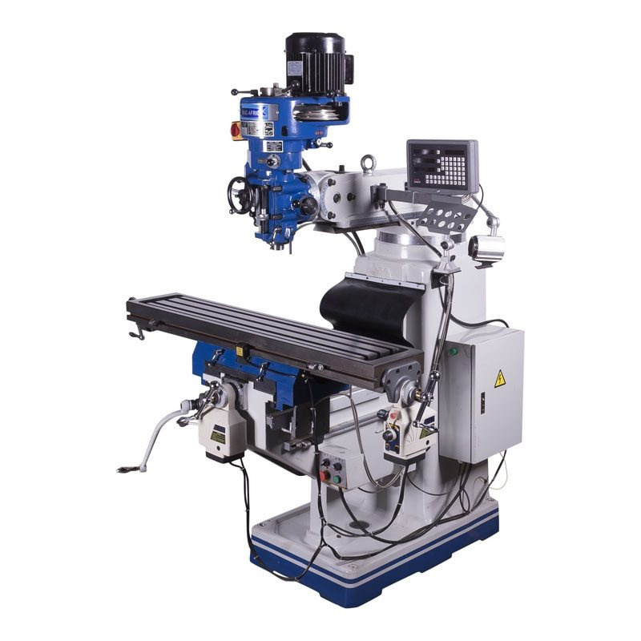
Problem Statement
- Unexpected machine failures in manufacturing environments lead to significant production downtime, increased maintenance costs, and reduced product quality.
- Traditional maintenance strategies, such as reactive or scheduled maintenance, fail to account for the complex interaction between multiple machine parameters.
- Machine failures are not caused by a single factor but rather by a combination of temperature, rotational speed, torque, and tool wear, making manual monitoring unreliable.

Slide 6
Project Objective
- The objective of this project is to develop a machine learning model that predicts machine failure in advance using sensor data from a milling machine.
- This allows maintenance actions to be taken before failure occurs, reducing downtime and operational costs while improving production reliability.

Slide 7


VALUE PROPOSITION
Transform from Reactive to Predictive Maintenance
30-40%
50%
20-30%
Reduce Costs
Minimize Downtime
Extend Asset Life
Lower maintenance expenses
Fewer unplanned outages
Optimal equipment usage
70%
25%
Real-time
Improve Safety
Boost Efficiency
Data-Driven
Prevent hazardous failures
Optimized production flow
Actionable insights

Slide 8

HOW IT WORKS
1
2
3
4
Data Collection
AI Analysis
Prediction
Action
Sensors capture real-time machine parameters
ML model processes data patterns
System forecasts potential failures
Maintenance teams receive alerts

Slide 9

DATASET: AI4I 2020 PREDICTIVE MAINTENANCE
Dataset Specifications
Monitored Parameters
Total Records
• Air Temperature (K)
10,000
• Process Temperature (K)
Features
5 Sensor Variables
• Rotational Speed (RPM)
Target Classes
2 (Failure/No Failure)
• Torque (Nm)
Class Distribution
• Tool Wear (minutes)
3.4% Failures

Slide 10

TECHNICAL CHALLENGE: CLASS IMBALANCE
The Imbalanced Dataset Problem
THE PROBLEM
THE SOLUTION: RANDOM OVERSAMPLING
Original dataset: 9,661 normal vs 339 failures (96.6% vs 3.4%). Models trained on imbalanced data become biased toward the majority class and fail to detect rare but critical failures.
Randomly duplicate minority class samples to balance the dataset. This ensures the model learns failure patterns effectively without introducing synthetic noise.
Before Resampling
After Resampling
Normal: 9,661 (96.6%)
Normal: 50%
Failures: 50%
Failures: 339 (3.4%)
Balanced training enables accurate failure detection

Slide 11

DATA PREPROCESSING PIPELINE
Data Cleaning
1
Removed identifier columns (UDI, Product ID) • Dropped categorical Type column • Removed failure type columns (TWF, HDF, PWF, OSF, RNF)
Feature Scaling
2
Applied MinMaxScaler normalization • Scaled all features to [0,1] range • Prevents feature dominance in ML model
Train-Test Split
3
80/20 split with stratification • Ensures balanced class distribution • Maintains data integrity
Resampling
4
RandomOverSampler on training set only • Balanced classes to 50/50 ratio • Test set remains untouched for realistic evaluation

Slide 12
FEATURE SCALING: WHY MINMAXSCALER?
Normalizing Features to Equal Scale
WITHOUT SCALING
WITH MINMAXSCALER
Features have vastly different ranges:
All features normalized to [0, 1]:
• Rotational Speed: 500-3000 RPM
• Torque: 0-100 Nm
• Tool Wear: 0-300 minutes
Formula: X_scaled = (X - X_min) / (X_max - X_min)
Result: Large values dominate, model performance degrades
Result: Equal feature contribution, improved model accuracy
MinMaxScaler vs StandardScaler
MinMaxScaler preserves the exact minimum and maximum boundaries of each feature, which is ideal for bounded sensor data (e.g., temperature ranges, RPM limits). StandardScaler uses mean and standard deviation, which can be influenced by outliers and doesn't preserve bounds. For sensor readings with known physical limits, MinMaxScaler maintains interpretability.

Slide 13

MODEL SELECTION & COMPARISON
Three Models Evaluated for Optimal Performance
Logistic Regression
Decision Tree
Random Forest ✓
Baseline binary classifier. Simple and interpretable.
Non-linear patterns, prone to overfitting on single tree.
100 decision trees ensemble. Handles complex interactions.
~85% Accuracy
~96-97% Accuracy
98.1% Accuracy (SELECTED)
RANDOM FOREST: FINAL METRICS
98.1%
98.0%
98.1%
98.1%
Accuracy
Precision
Recall
F1-Score
Overall prediction correctness
True failures among predicted failures
Detected failures among all failures
Harmonic mean of precision & recall

Slide 14
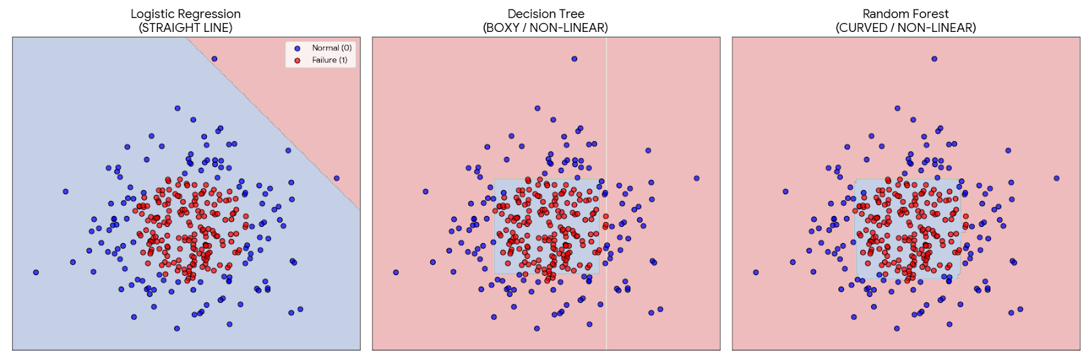
MODEL SELECTION & COMPARISON

Slide 15
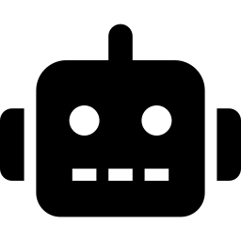
USER INTERFACE: STREAMLIT APP
Intuitive Real-Time Prediction Interface
Input Parameters
Users enter 5 sensor readings via intuitive number inputs with validated ranges
One-Click Prediction
Single button click processes data through MinMaxScaler and Random Forest model
Instant Results
Clear visual feedback showing failure prediction with confidence percentage
Model Metrics
Sidebar displays model performance stats: 98.1% accuracy, precision, and recall
Built with Streamlit for rapid deployment and user-friendly ML predictions

Slide 16
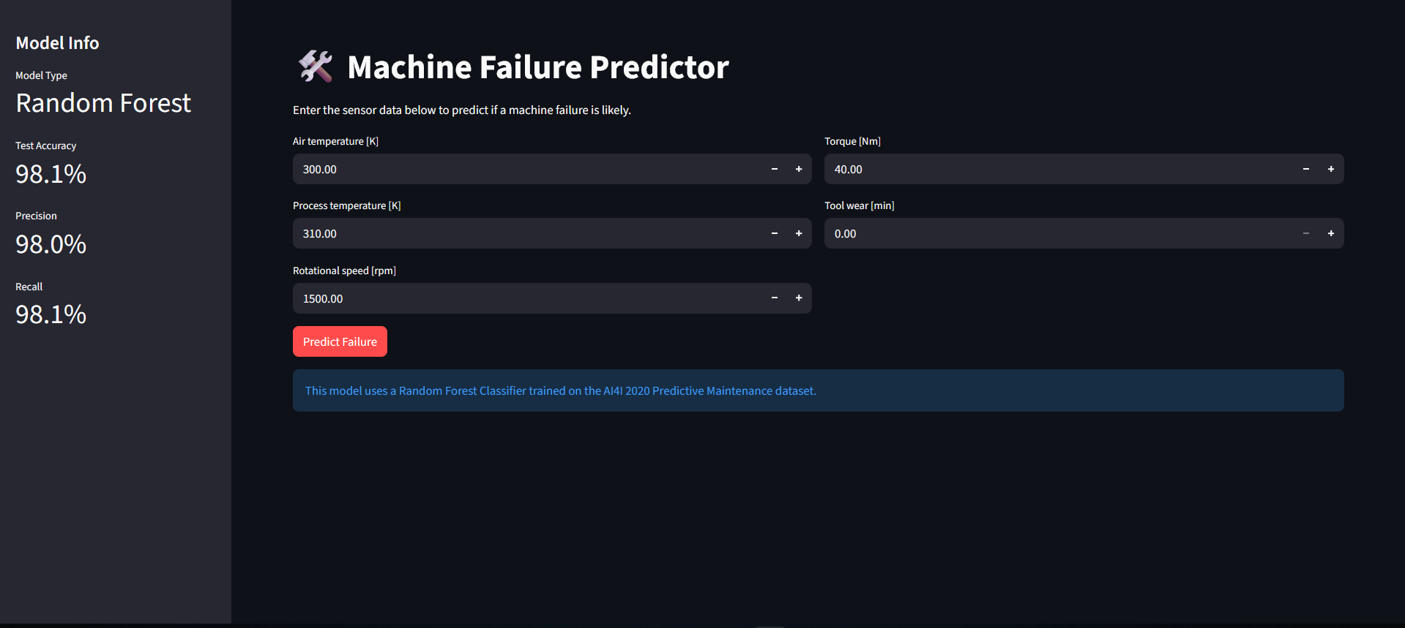


Slide 17
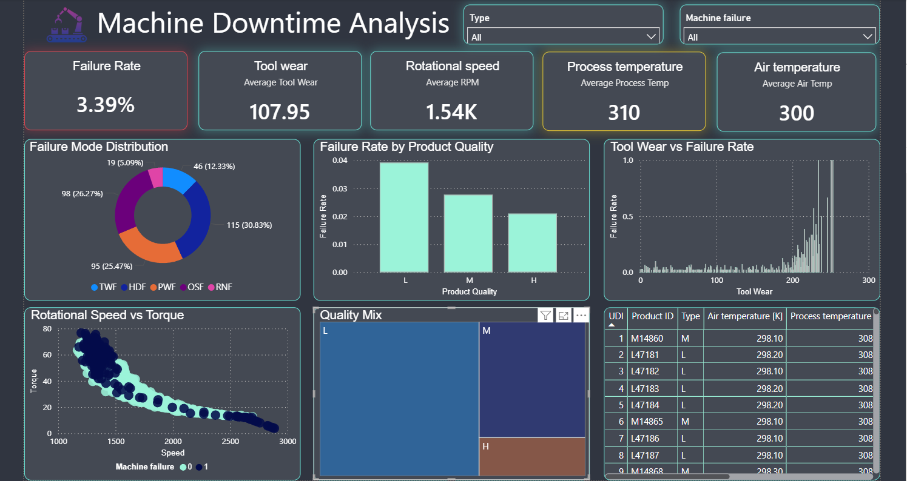

Slide 18
PROJECTED BUSINESS IMPACT
Quantifying the Value of Predictive Maintenance
Annual Savings
Reduced downtime ($1.5M) + Lower repair costs ($1M) + Extended equipment life ($500K - $1.5M)
$2.5M - $4M
Downtime Reduction
From 200+ hours/year to <80 hours through early failure detection and planned maintenance
50-70%
Equipment Lifespan
Optimal maintenance timing prevents catastrophic failures and premature replacements
+25%
Safety Incidents
Proactive failure prevention eliminates most equipment-related workplace accidents
-70%

Slide 19
THANK YOU
THANK YOU

